Slide 1
New Furnishings Products for Fall 2023
It's no surprise the way staff and residents use Senior Living spaces has changed in recent years. This year, we’re seeing top Senior Living manufacturers launch new products that were designed with durability, resident independence, and staff efficiency in mind.
Explore new products for 2023 in this guide and contact your Direct Supply representative for more information on any of the products featured.

Slide 2
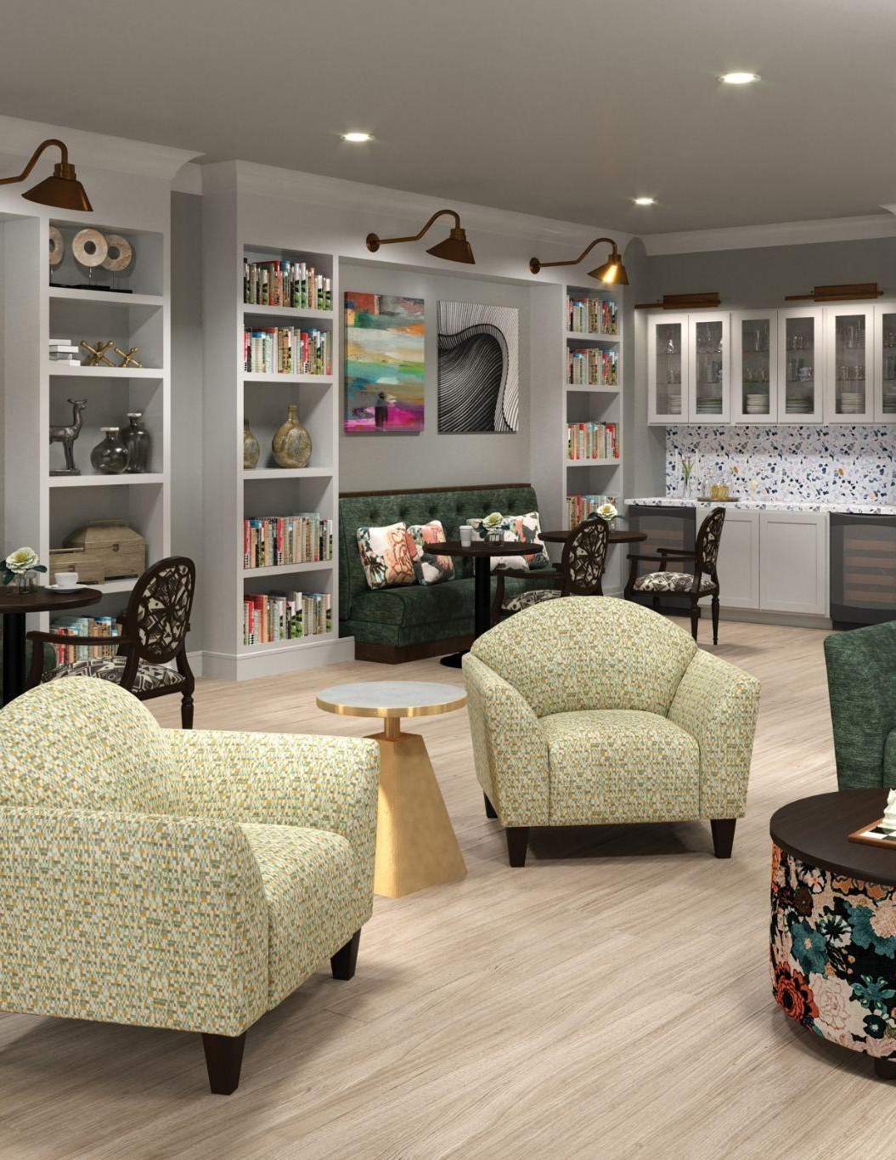
Common Area & Dining Room
Many of this year’s products follow the same trend: Fostering community while maintaining cleanability and durability.
Communities are continuing to foster dedicated spaces for resident and family gatherings. Strategic design trends such as high-back chairs and products that promote cleanability allow for community to grow in a safe fashion.

Slide 3
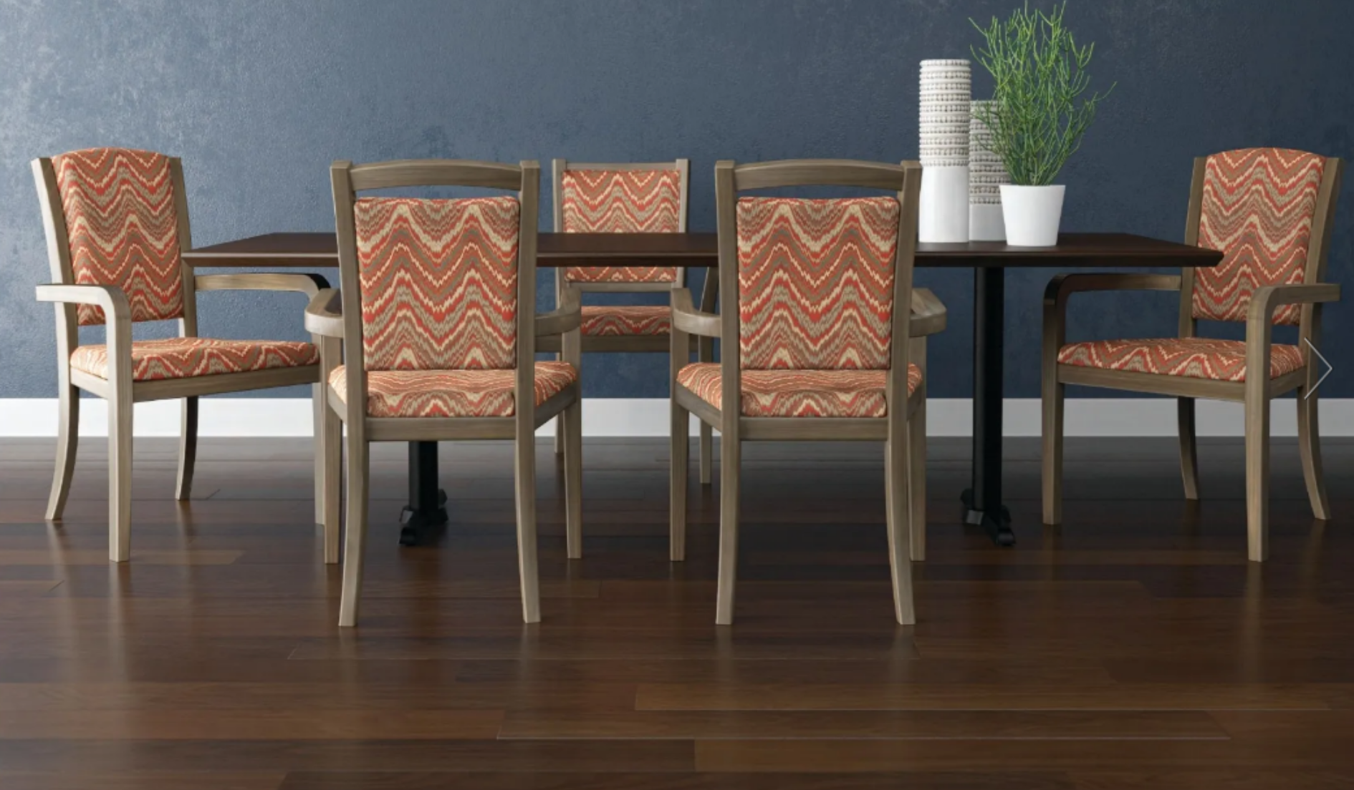
BeyondWood™ Composite Chairs: The Wexford, Salthill, and Kylemore
Learn more about this new and innovative collection: https://www.maxwellthomas.com/news/beyondwood/

Slide 4
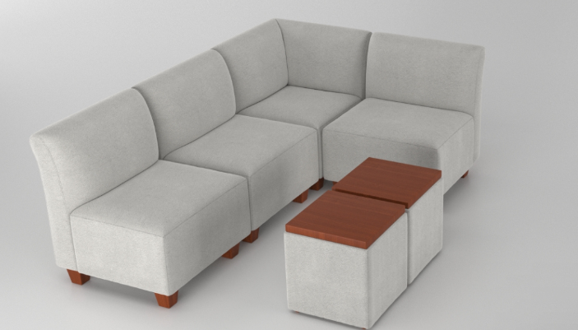
Levelland Collection
Bartlesville Modular Collection

Slide 5
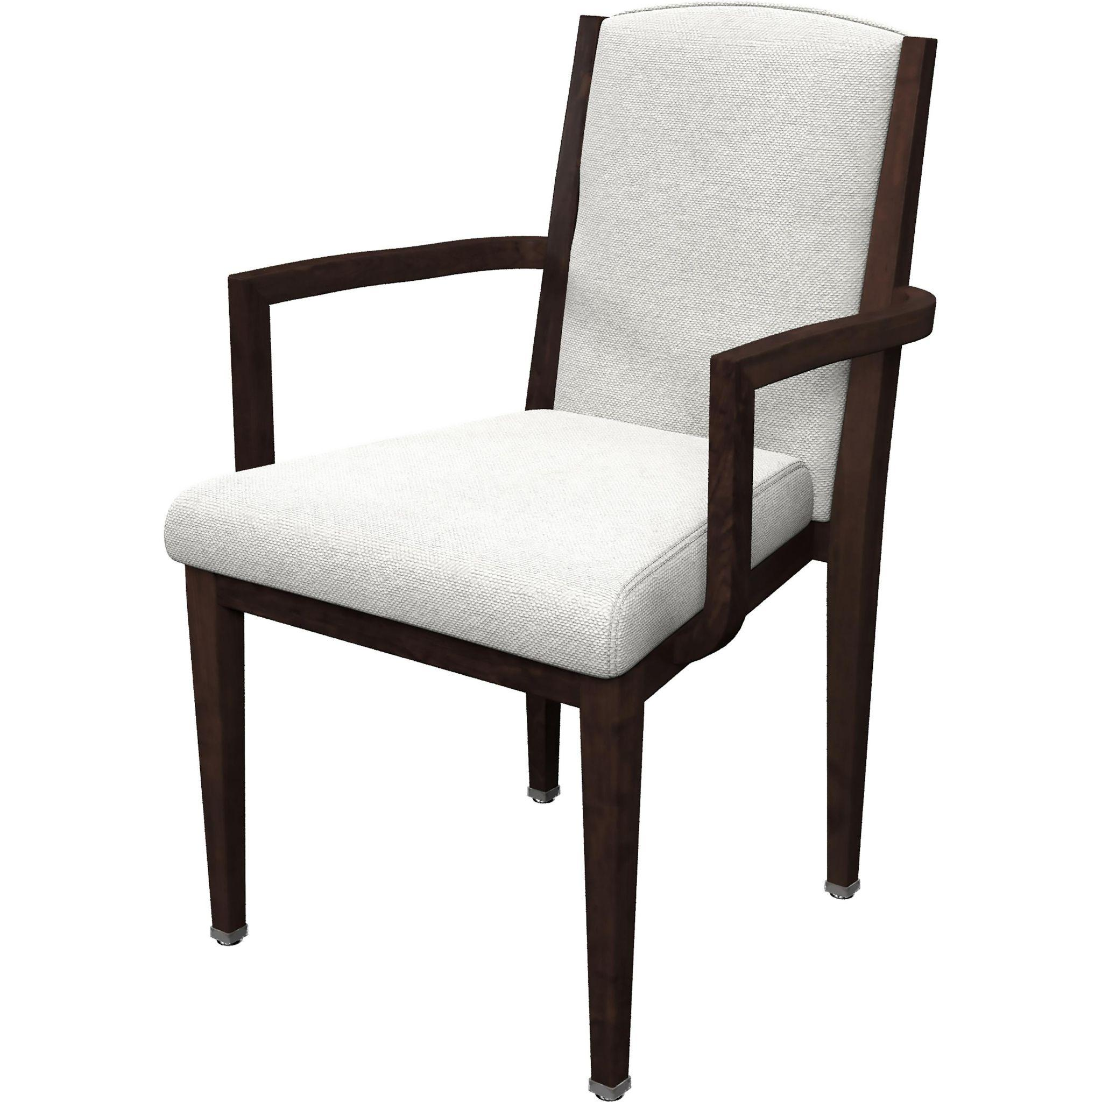
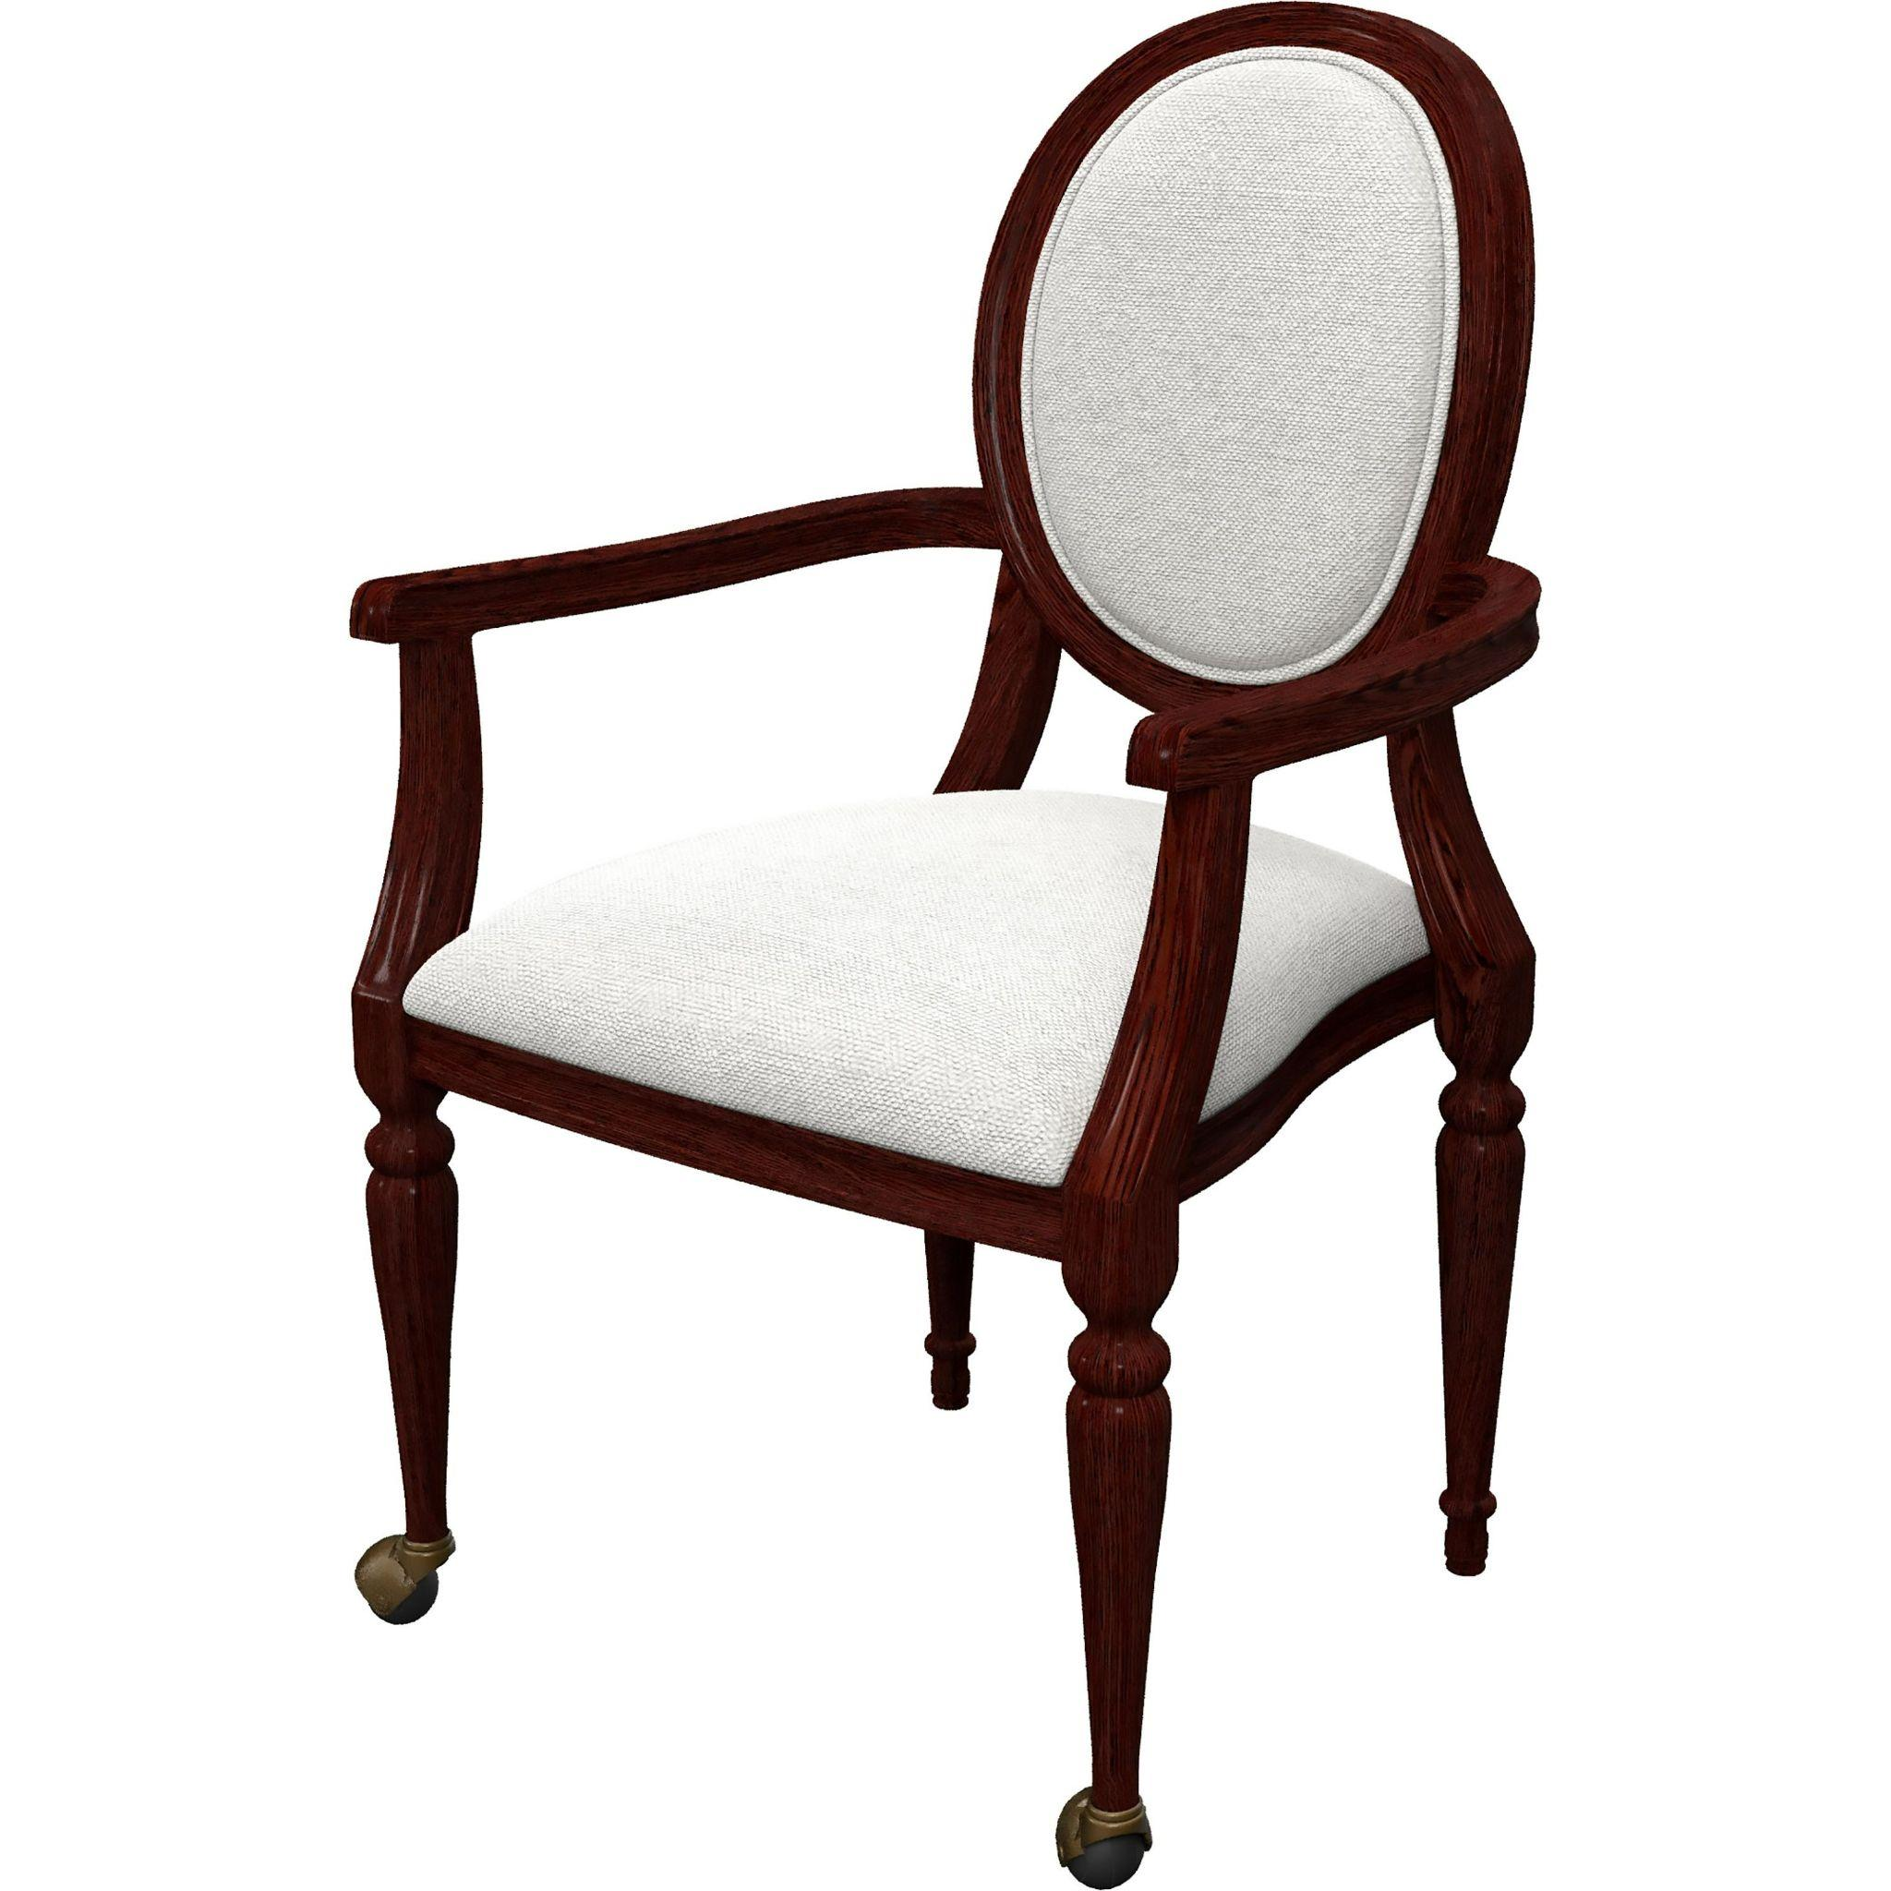
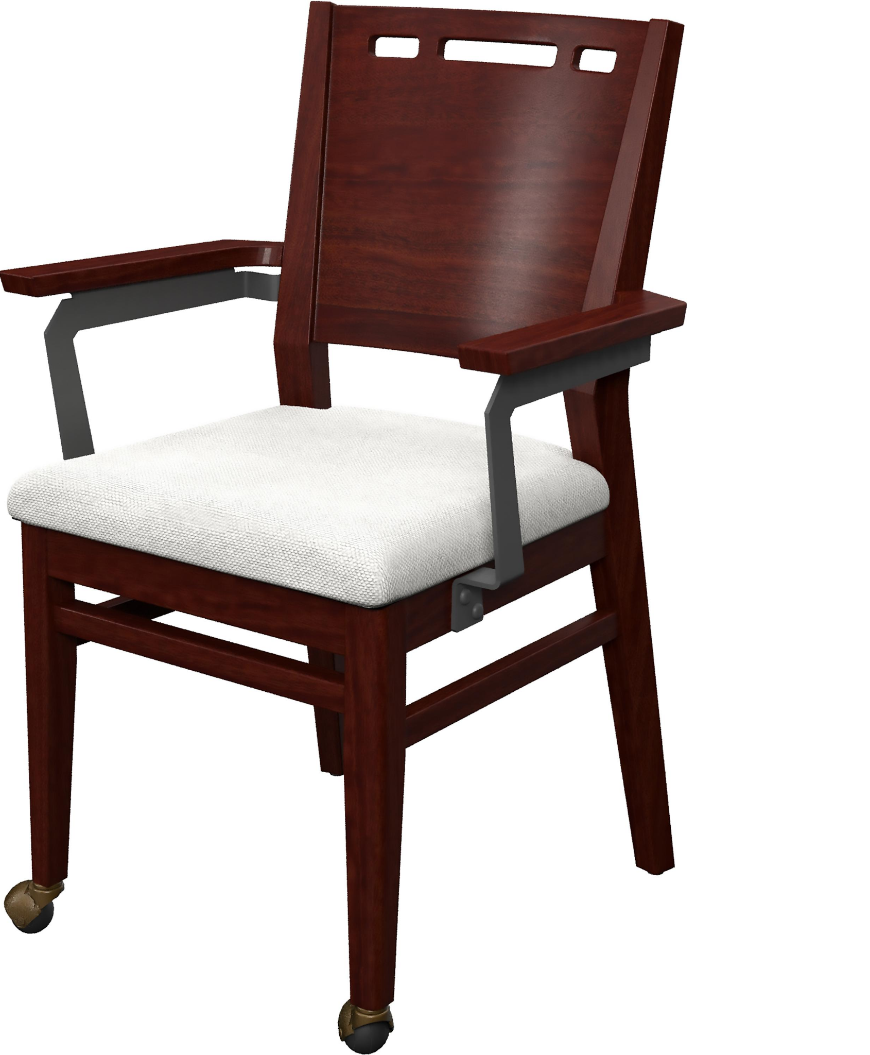
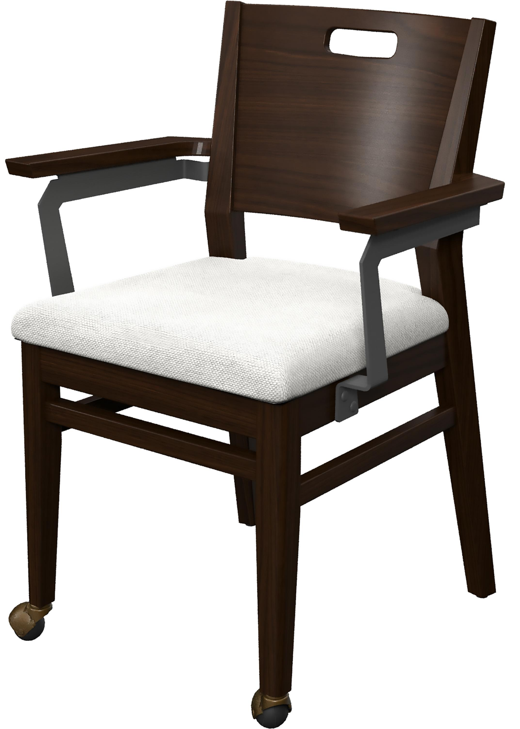
Boyceville
Hampden
Hinsdale
Billesley
Sparkbrook
Lakecrest Farm
Discover dining furniture from Direct Supply: https://store.directsupply.com/catalog/furnishings-dining-room-furniture-23297

Slide 6
Coral City
Deronda
Grandillo Table Base

Slide 7
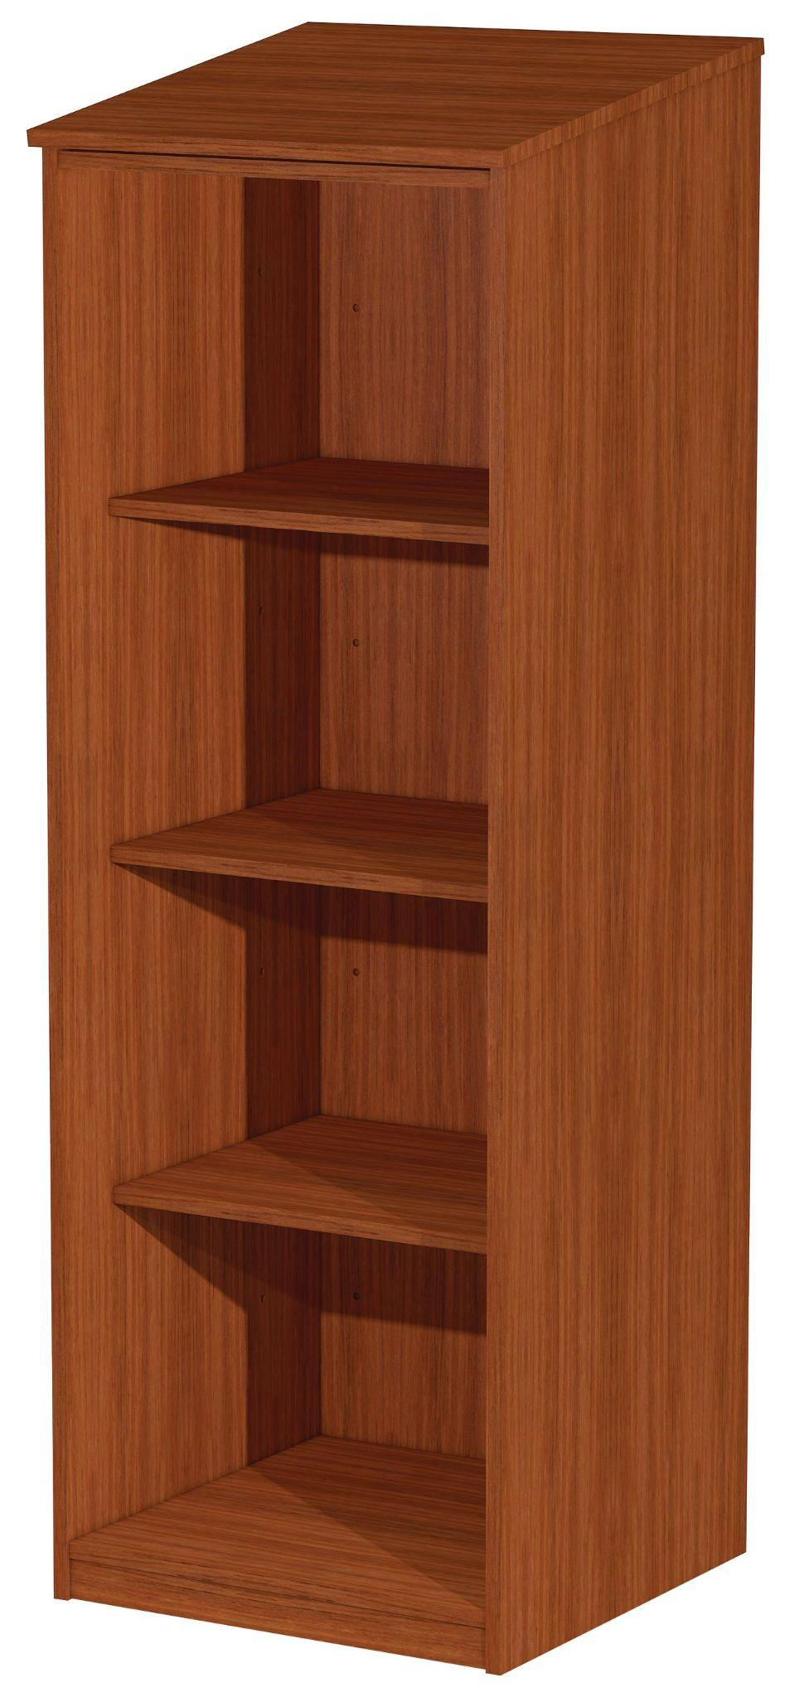
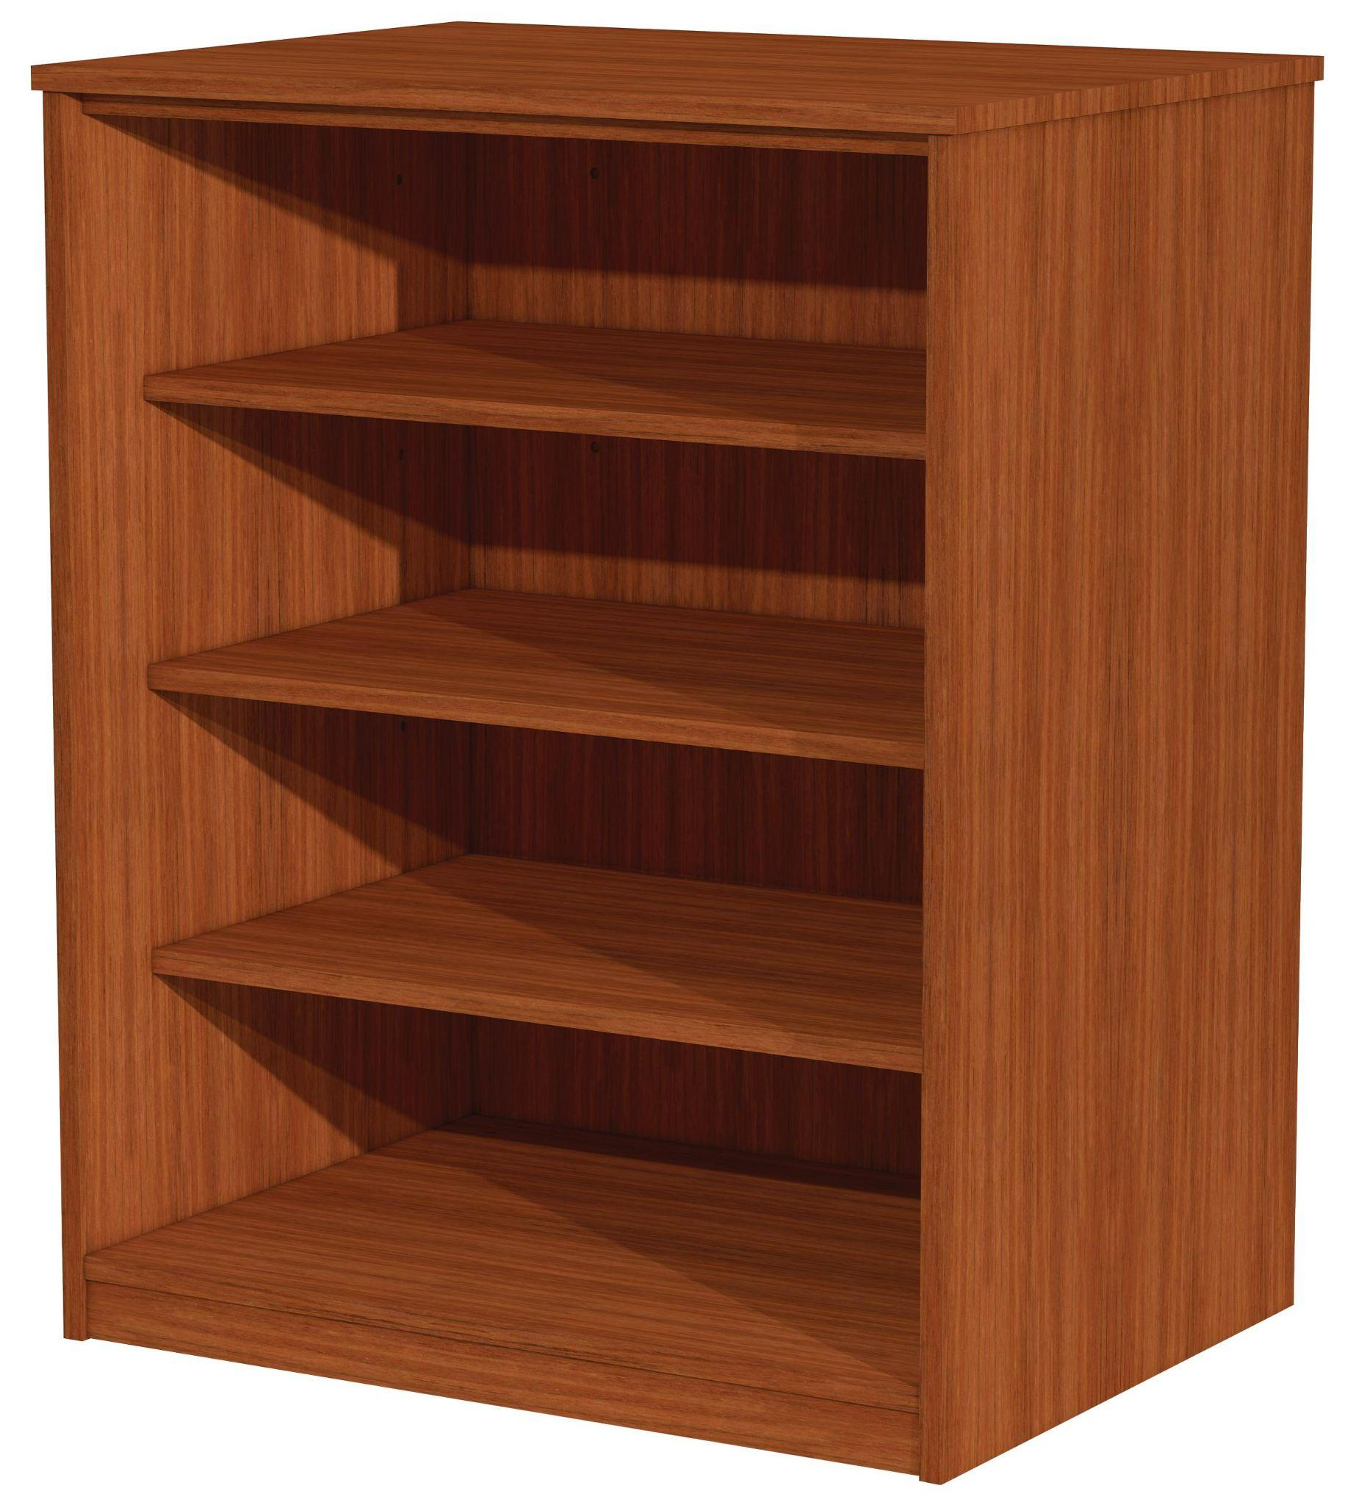
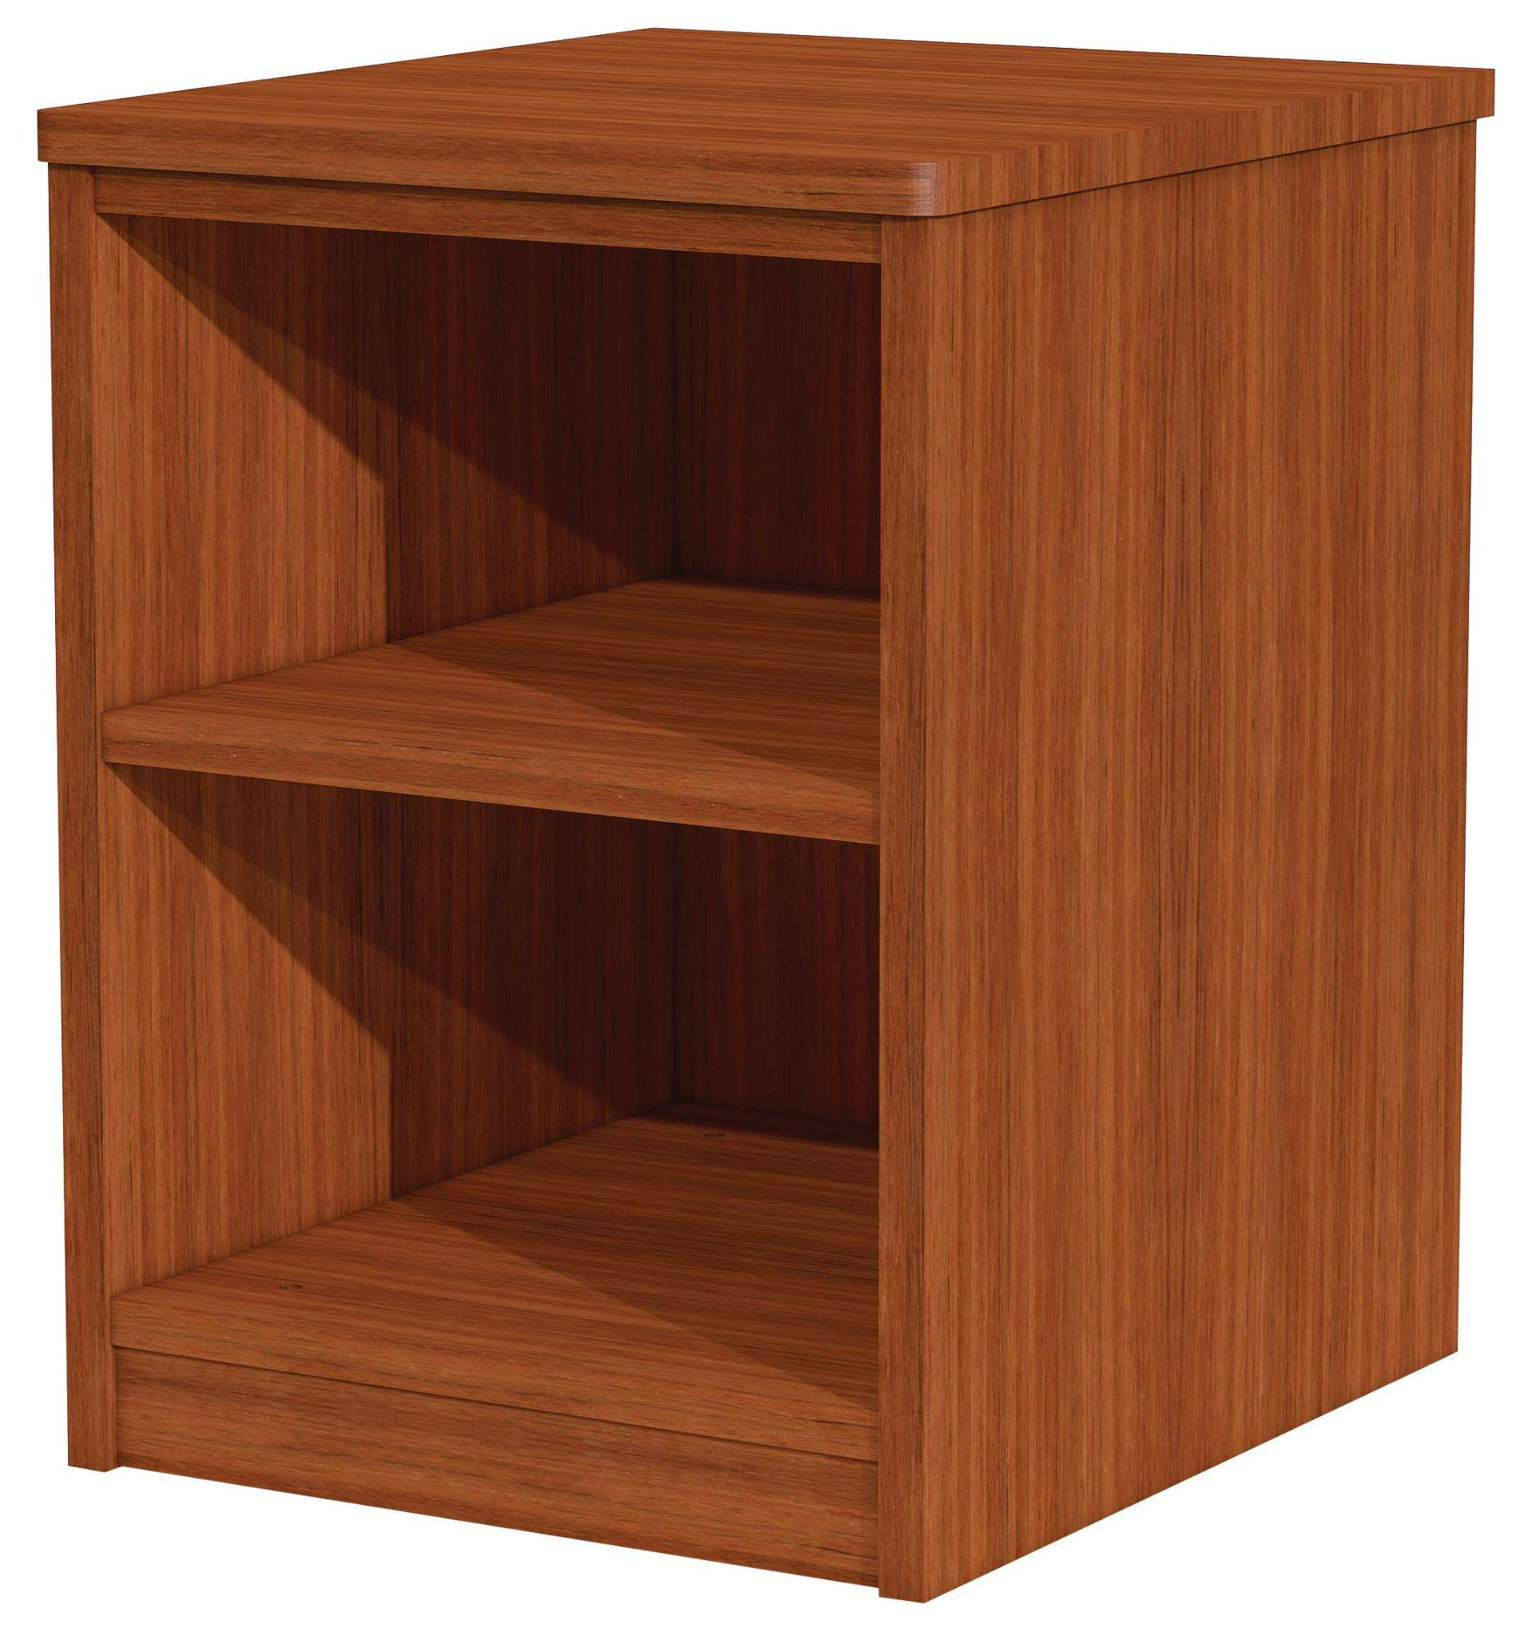
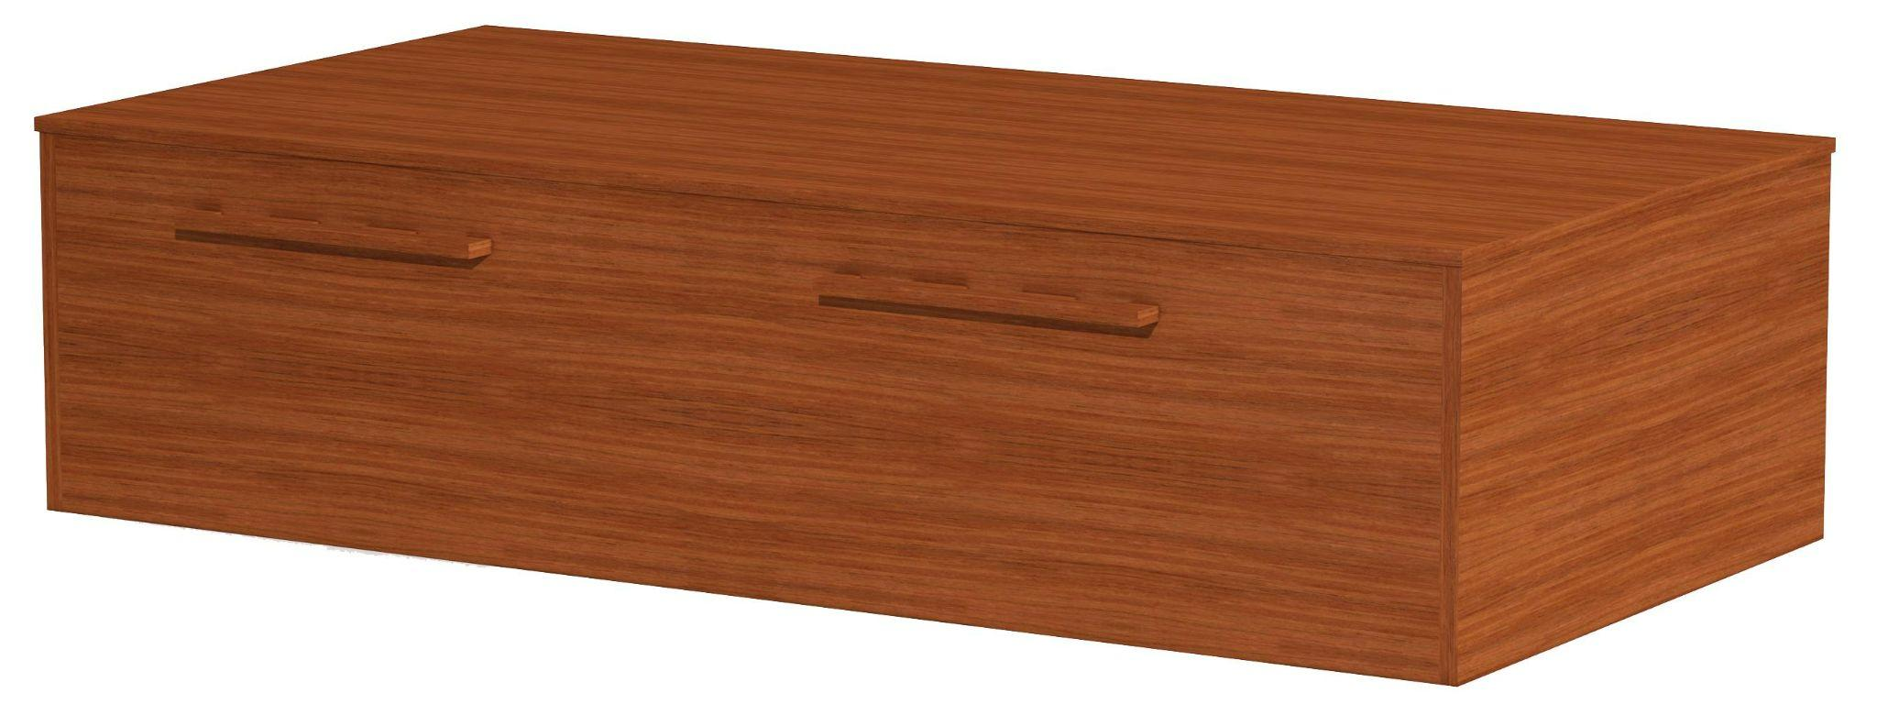
Nightstand
Collection Storage, 3 Shelves
Collection Storage, Slope Top
Bed, Flush Platform
Direct Supply® Behavioral Health Casegoods

Slide 8
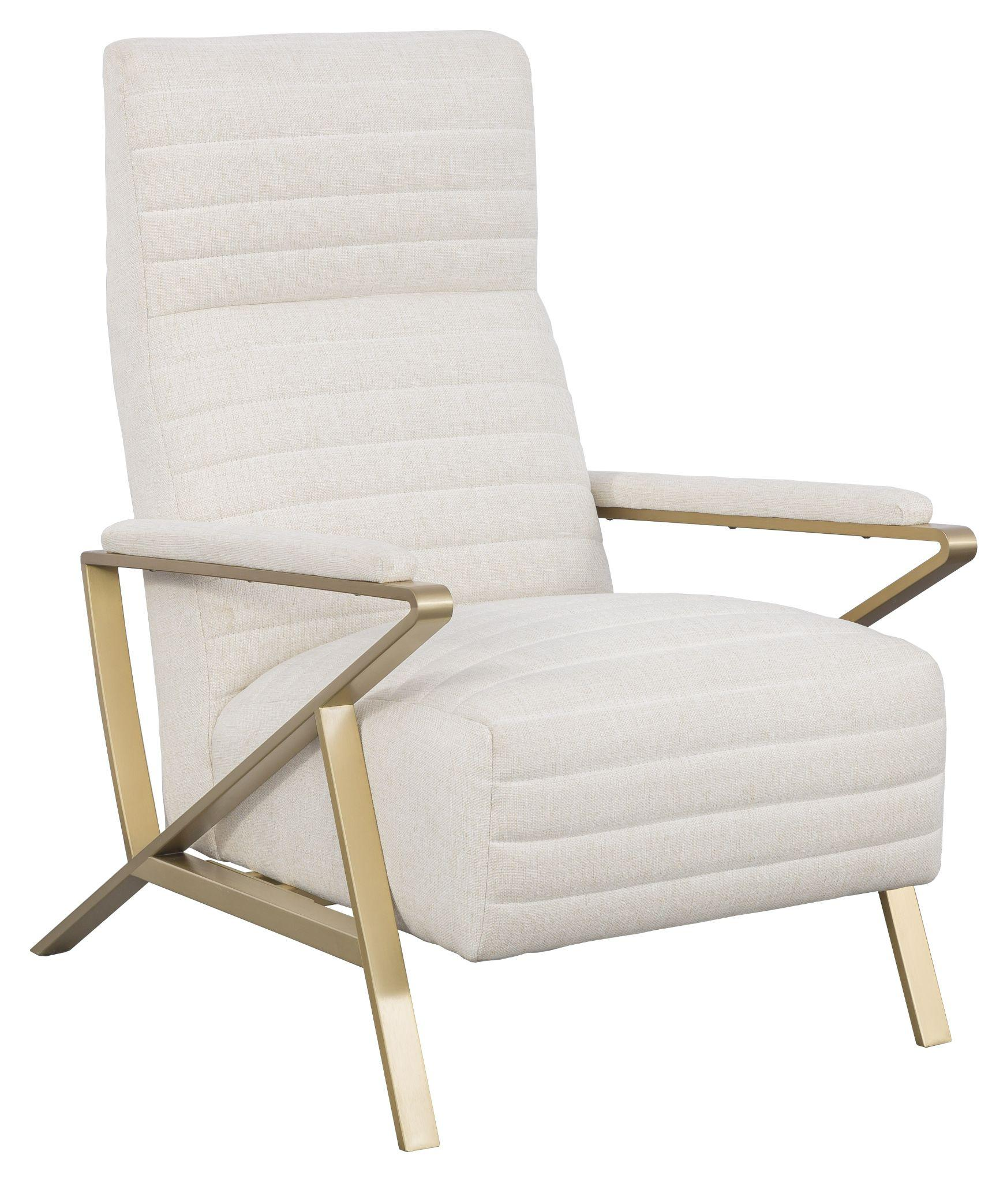
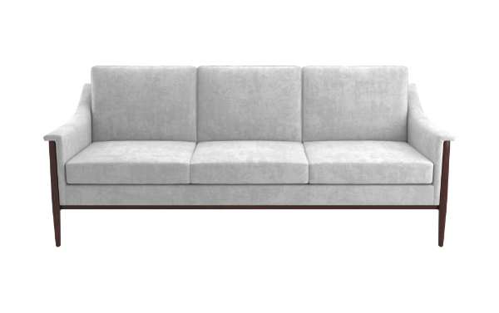
Infinity Occasional Chair
Smart Chair Mini
Dudley Sofa
Explore common area furniture from Direct Supply: https://store.directsupply.com/catalog/furnishings-common-area-furniture-22919

Slide 9
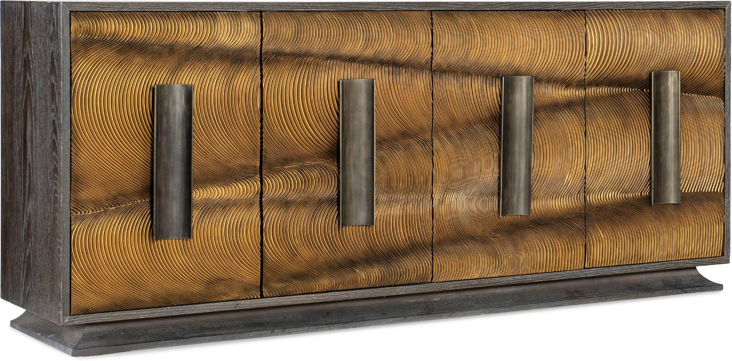
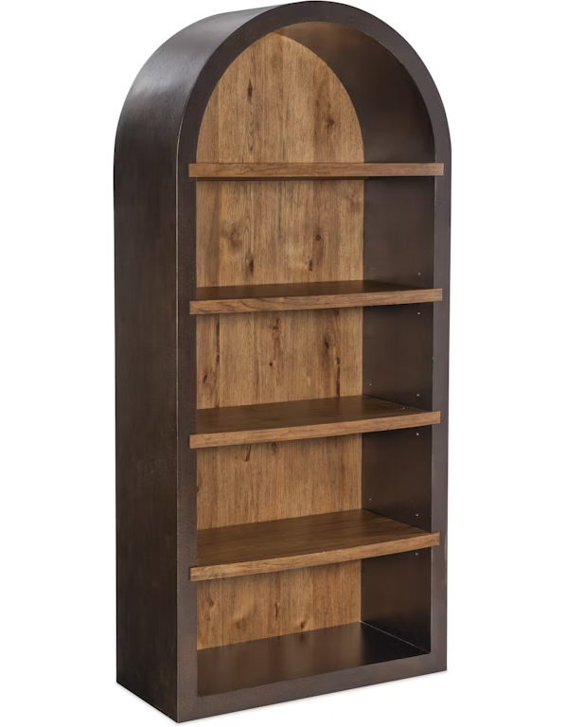
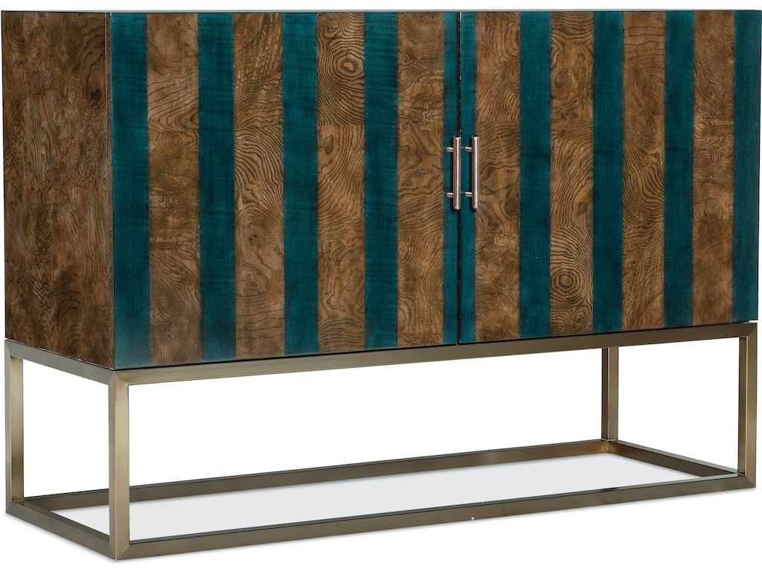
Melange Swaley Four Door Credenza
Big Sky Etagere
Melange Devynn Two Door Chest

Slide 10
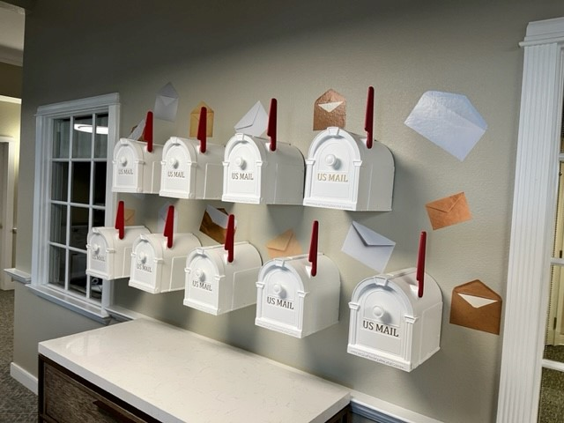
Memory Care Mailboxes

Slide 11
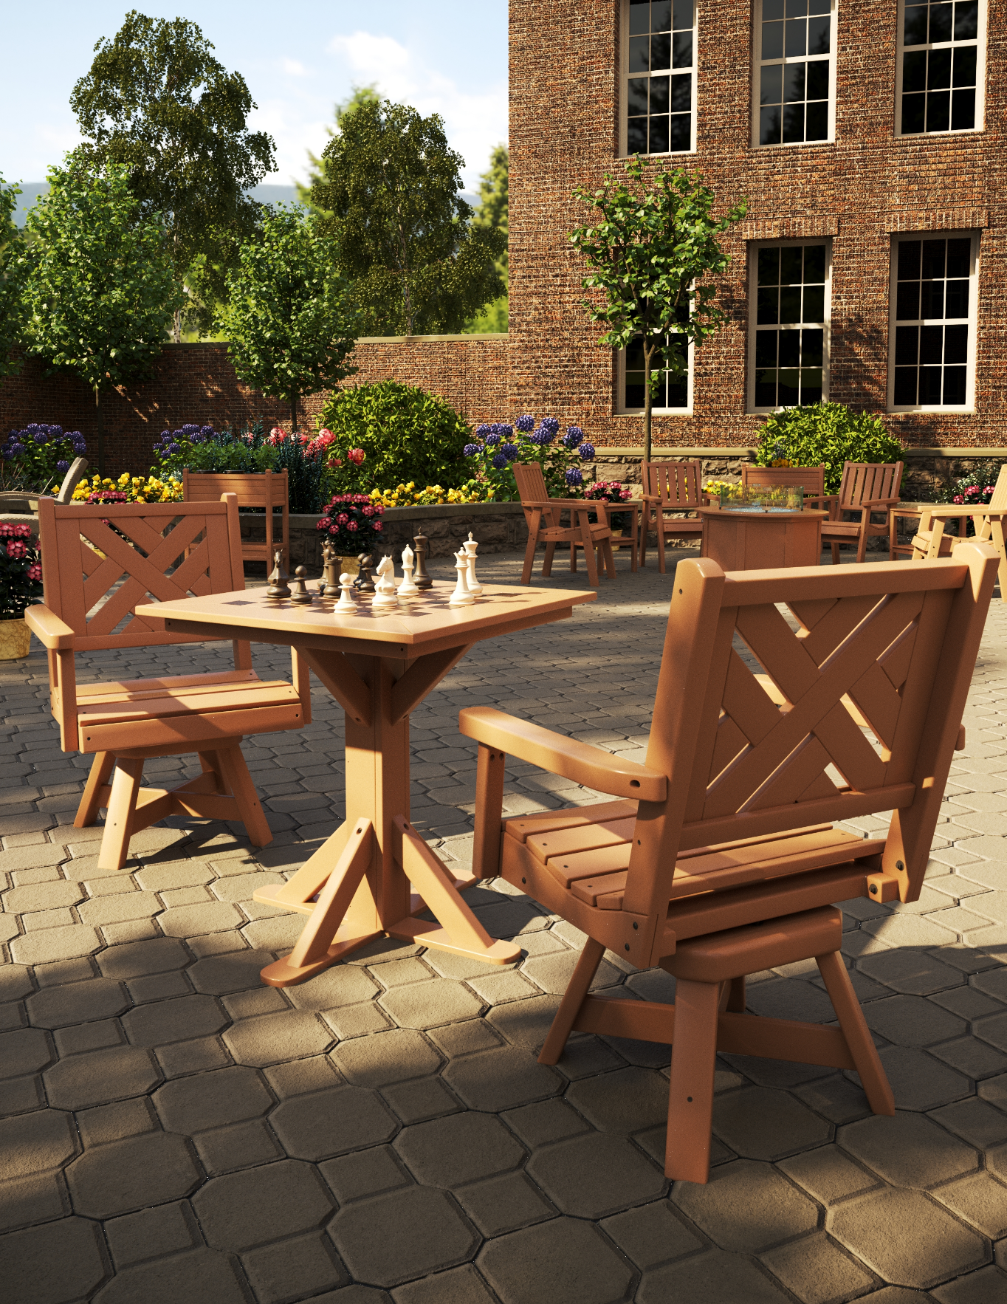
Outdoor Spaces
Providers will continue to invest in outdoor gathering spaces to bring communities together. Durable, low-maintenance outdoor furnishings are key to creating attractive outdoor spaces that bring residents and family back together, all while staying safe and providing a healthy dose of vitamin D.

Slide 12
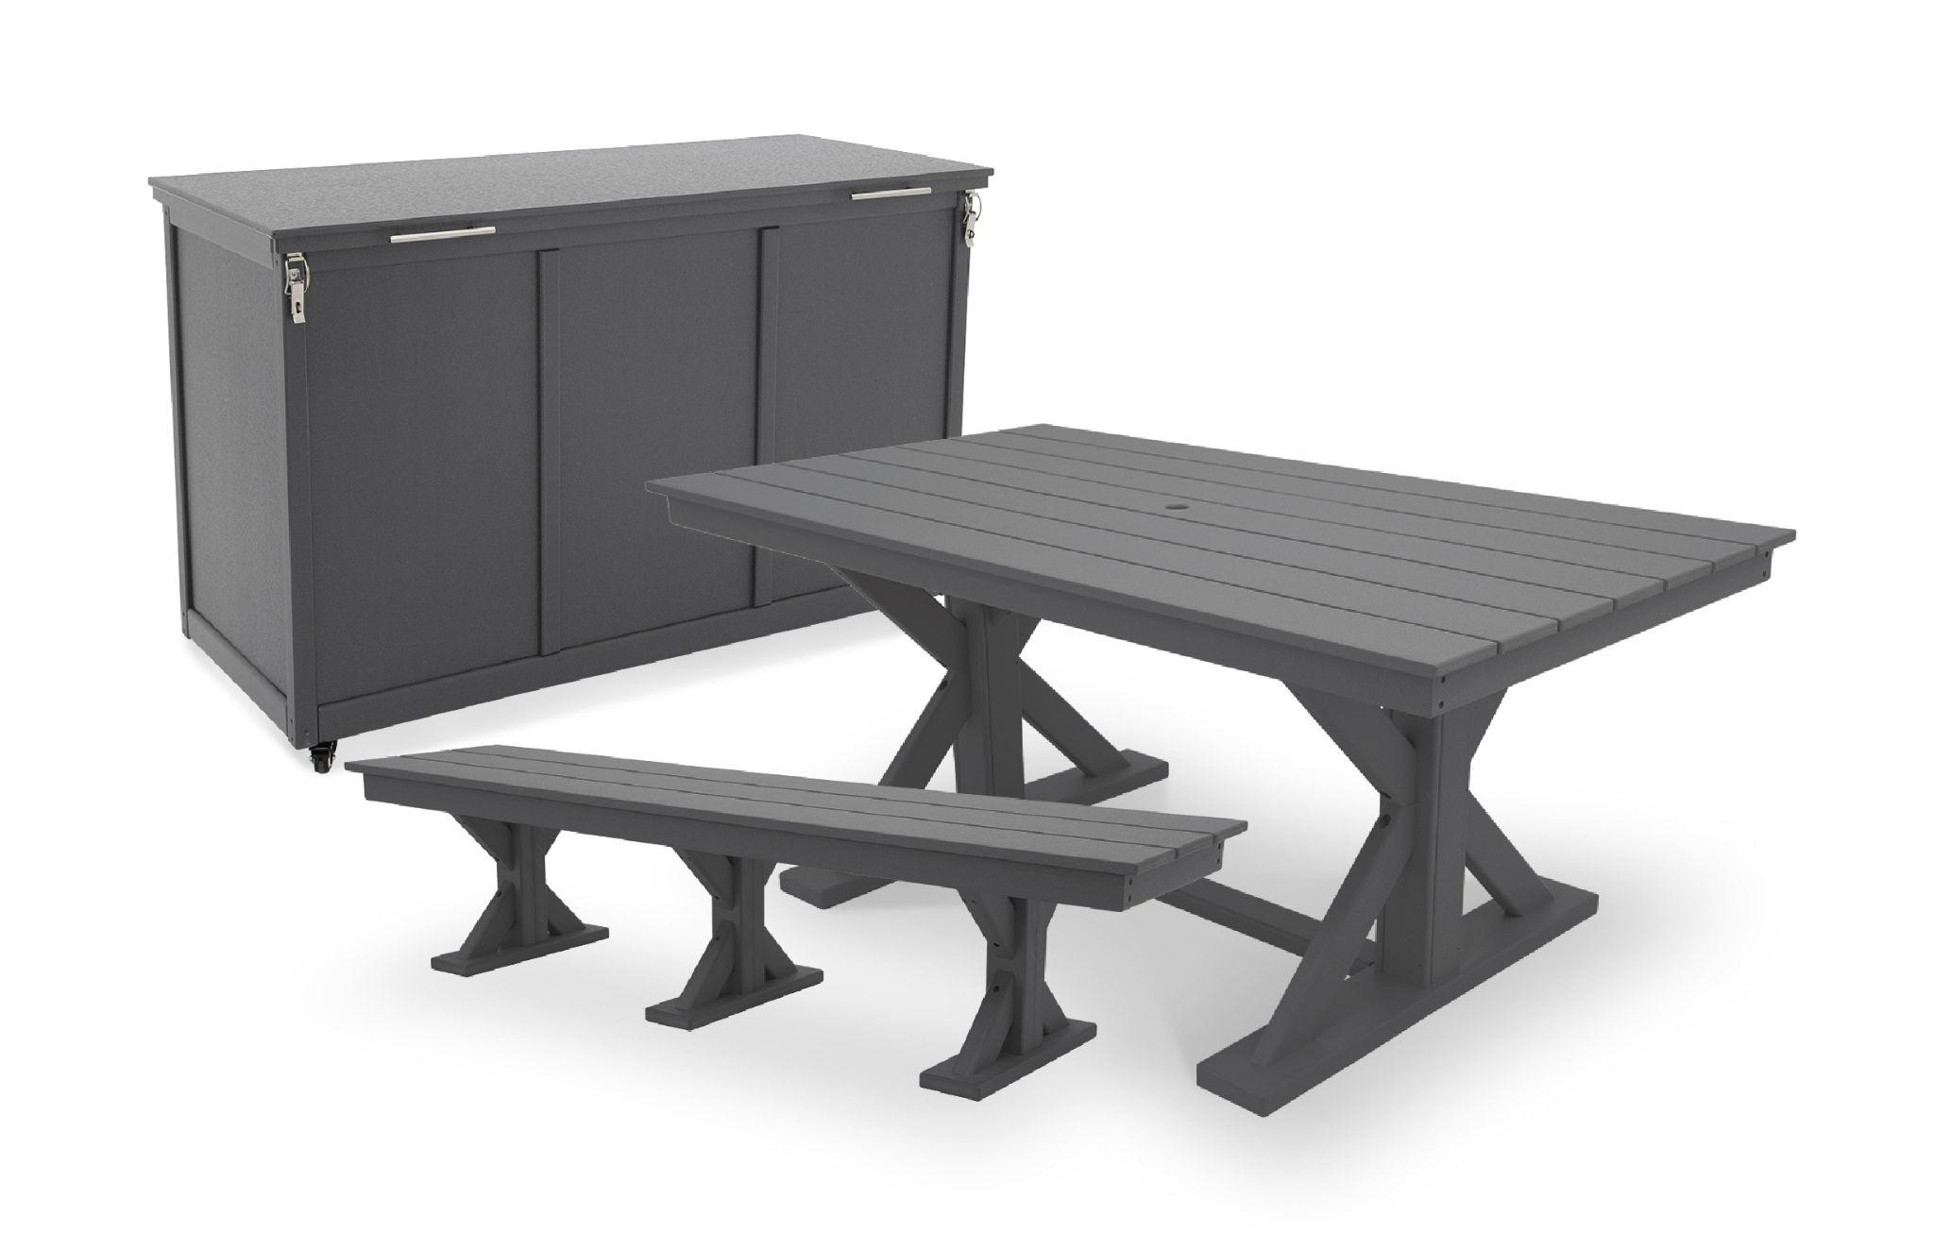
Storage Box
Farmhouse Table
Farmhouse Bench
Explore outdoor furniture from Direct Supply: https://store.directsupply.com/catalog/furnishings-specialty-room-furniture-outdoor-furniture-22923

Slide 13
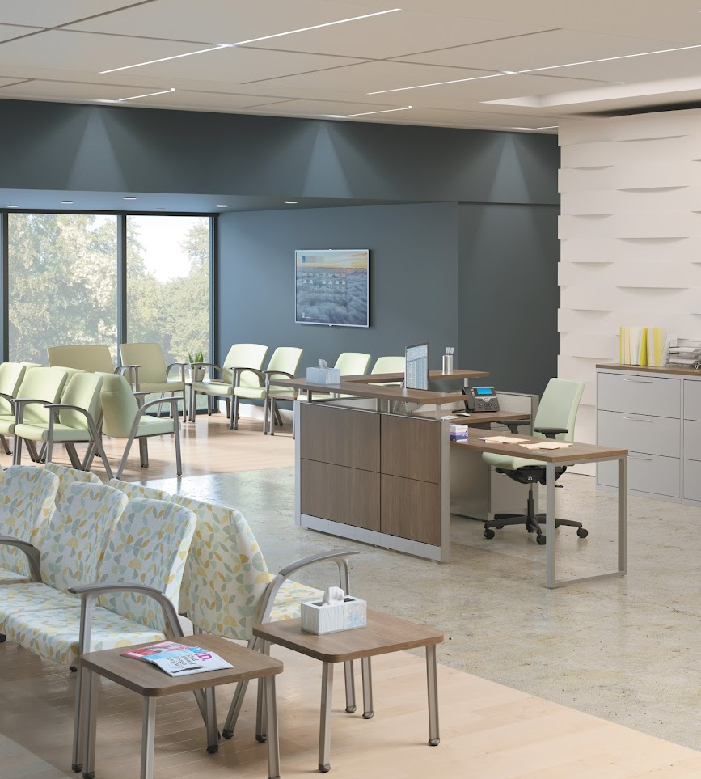
Healthcare Furniture
We can now offer the same service & experience you have come to expect on any Acute or Behavioral Health project.

Slide 14
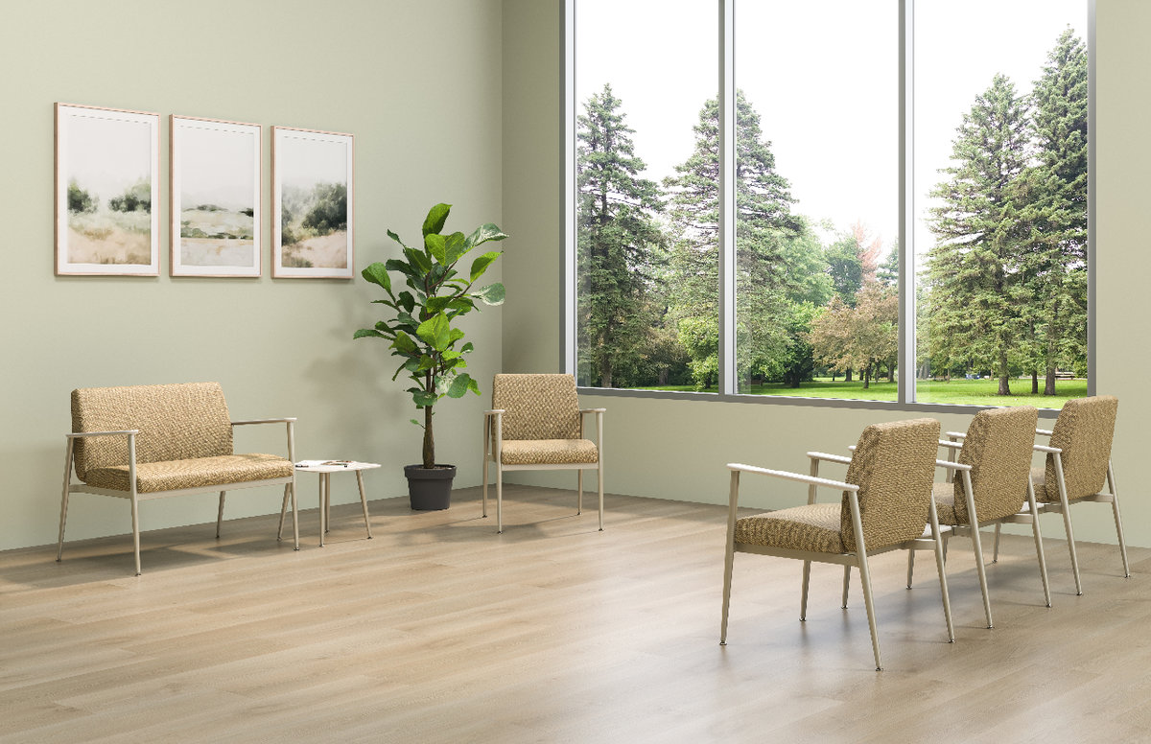
Spry Collection

